Slide 1

Predicting Business Ratings Using Azure ML, Spark ML & Oracle DBCE
Oluwatofunmi Alabi
Raymond Delgado
Sweta Tripathi
Uchechukwu Okafor
CIS 5560
Professor Jongwook Woo

Slide 2
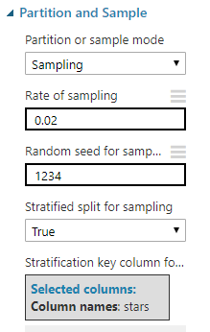
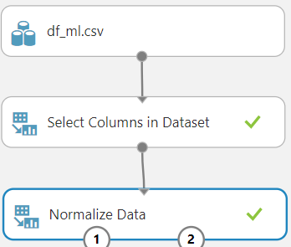

Slide 3

Introduction
Yelp online reviews allow users to provide their opinion for other people on what businesses to patronize.
Rating helps customers to obtain useful information of products.
To provide a business overview, one solution is to give the business a 1-5 star(s).
Prediction of rating is important for the business to take corrective measures.
Our goal is to predict ratings using various machine learning model.
Notes:
T

Slide 4

About the Dataset
Data Source : Kaggle.com
Dataset URL : https://www.kaggle.com/darshank2019/review
Products reviewed between 2007 and 2018 in US
Original File Size : 4.74 GB
Number of Rows : 6.6 Millions
Number of Columns : 9
Number of File : 1
File Format : CSV (Comma Separated Values)
Notes:
T

Slide 5
Features
Features
date
user_id
business_id
review_id
text
Labels
stars
funny
useful
cool
Notes:
T

Slide 6
Technical Specifications
Azure ML
Free Workspace
10 GB storage
Single node
Spark ML
DataBricks Subscription
Cluster 6.5 (includes Scala 2.11, Apache Spark 2.4.5)
15.3 GB Memory, 2 Cores, 1 DBU
Python Version 3
Notes:
T

Slide 7
Flowchart
Data Selection
Data Engineering
Data Cleaning
Data Preprocessing
Data Transformation
Data Split
Introduce Algorithm
Train & Test Model
Evaluate
Notes:
T

Slide 8
Data Analysis
Subset = 78 MB
Number of Rows = 120,000
User_ID(unique) = 93,921
Business_ID(unique) = 14,766
Review_ID(unique) = 120,000
Cleaned the dataset
Converted alphanumeric columns into numeric values
Generated new columns from the existing columns: bigrams, day, month
Notes:
U

Slide 9


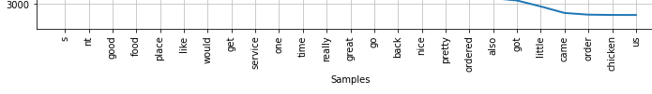

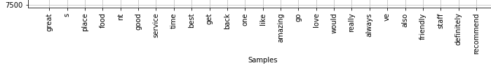
Data Analysis
Top 25 Words for Each Rating
1 star
2 stars
3 stars
4 stars
5 stars
Notes:
U

Slide 10
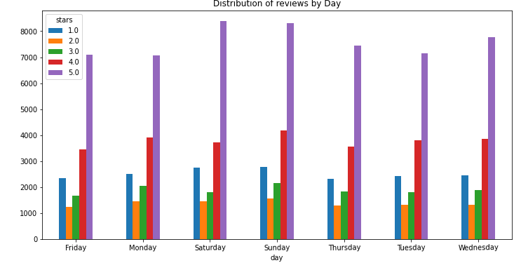
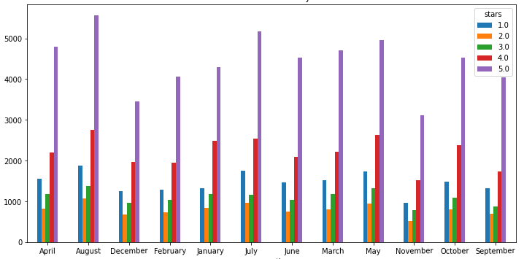
Data Analysis
Notes:
U

Slide 11
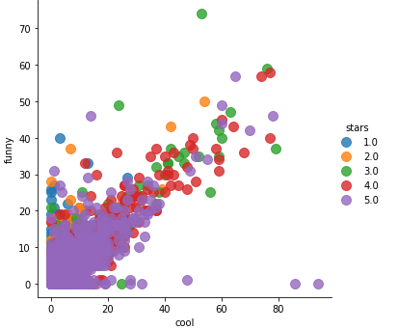
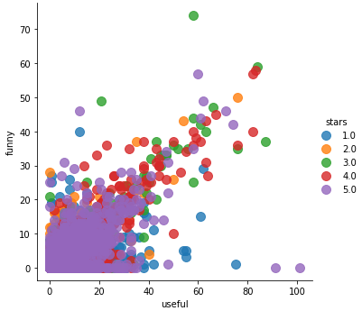
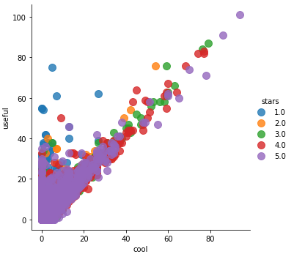
Data Analysis
Relationship graph between stars, funny, useful and cool columns
Notes:
U

Slide 12
Algorithms Used
Azure ML
Matchbox Recommender
Multiclass Decision Forest
Two class Decision Forest
Boosted Decision Tree
Spark ML & Oracle DBCE
Logistic Regression
ALS Collaborative Filtering
---
Notes:
R

Slide 13

Sampling
Original Dataset : 4.74 GB
Sampled Dataset : 74.1 MB
Time Taken : 6 Minutes
Stratified Split ensures that the output dataset contains a representative sample of the values in the selected column. This means common values will not affect the accuracy of the model.
Notes:
R

Slide 14
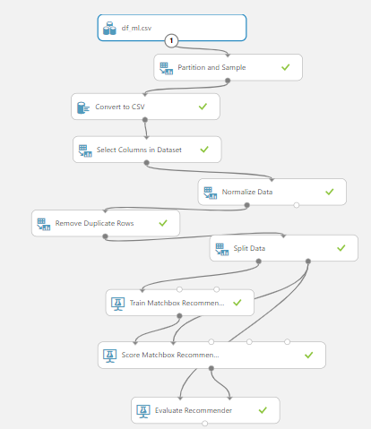
Matchbox Recommender
2% Sample
Time Taken : 6 Mins
70:30 Split Train/Test
Rating Prediction
Notes:
R

Slide 15
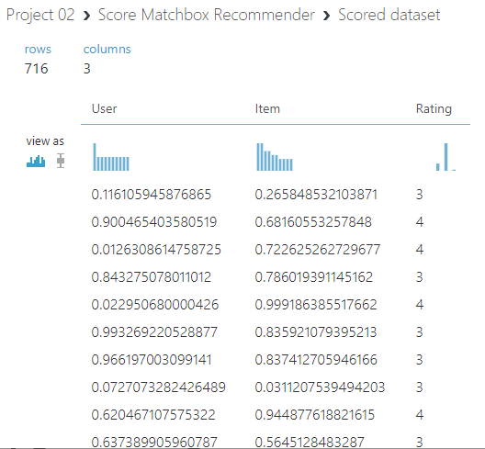
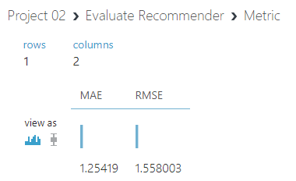
Matchbox Recommender
Rating Prediction
Features used:
Business ID
User ID
Stars
Notes:
R

Slide 16
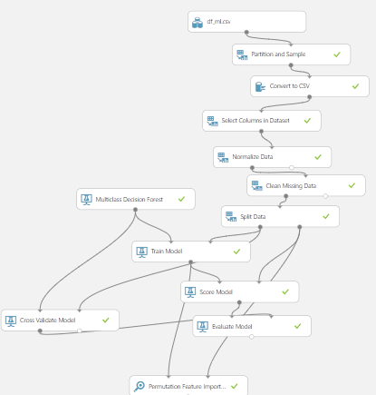
Multiclass Decision Forest--Classification
2% Sample
70:30 Split Train/Test
Cross-Validation
Tune Model Hyperparameters
Permutation Feature Importance
Time Taken: 3 Mins
Notes:
R

Slide 17
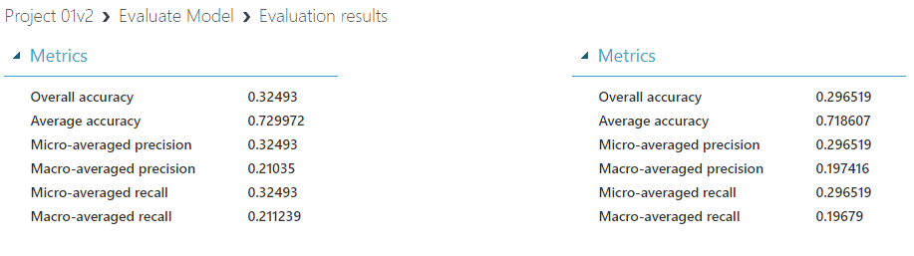
Decision Forest Regression
Evaluation Metrics
Features used:
Date
Business ID
Label used:
Star
Notes:
R

Slide 18
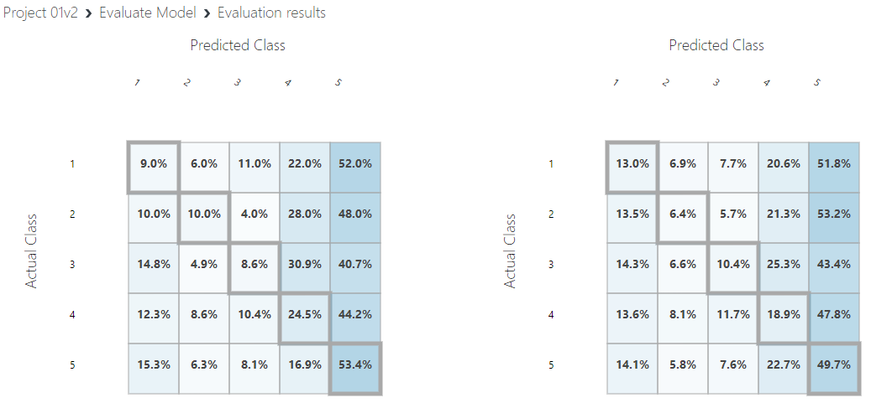
Decision Forest Regression
Evaluation Metrics
Notes:
R

Slide 19
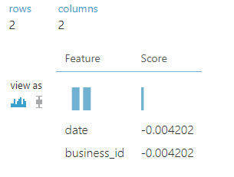
Decision Forest Regression
Permutation Feature
Notes:
R

Slide 20
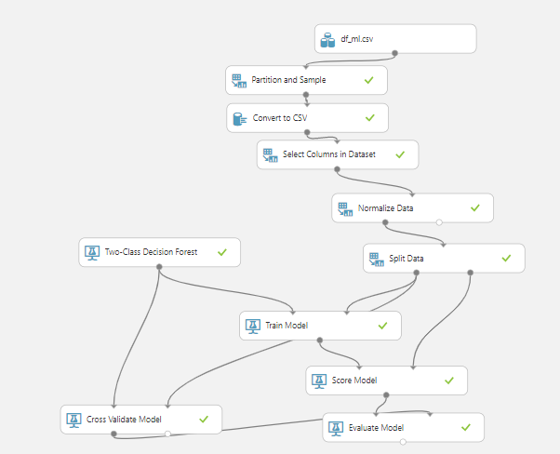
Two Class Decision Forest--Classification
2% Sample
70:30 Split Train/Test
Cross-Validation
Tune Model Hyperparameters
Permutation Feature Importance
Time Taken: 2 Mins
Notes:
R

Slide 21
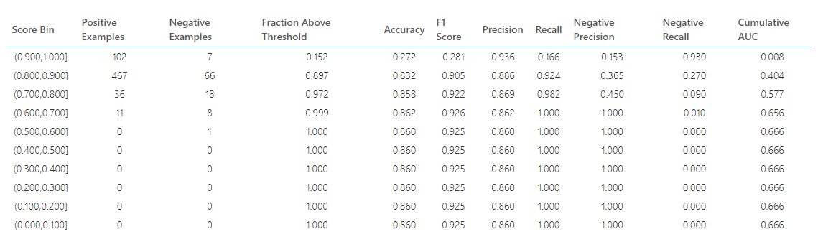
Decision Forest Regression
Evaluation Metrics
Features used:
Date, Business ID, Review ID, User ID, Funny, Cool, Useful
Label used:
Star
Notes:
R

Slide 22
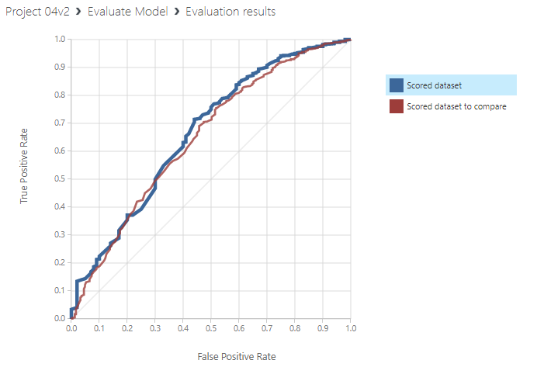
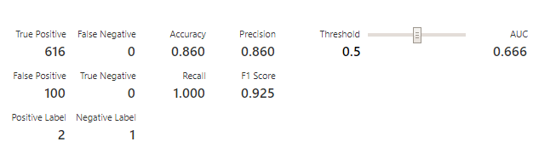
Decision Forest Regression
Evaluation Metrics
Notes:
R

Slide 23
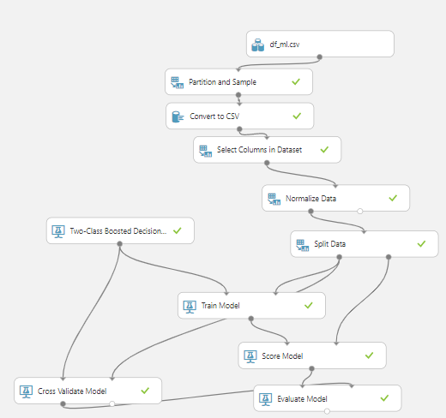
Two Class Boosted Decision Tree--Classification
2% Sample
70:30 Split Train/Test
Cross-Validation
Tune Model Hyperparameters
Permutation Feature Importance
Time Taken: 4 Mins
Notes:
T

Slide 24
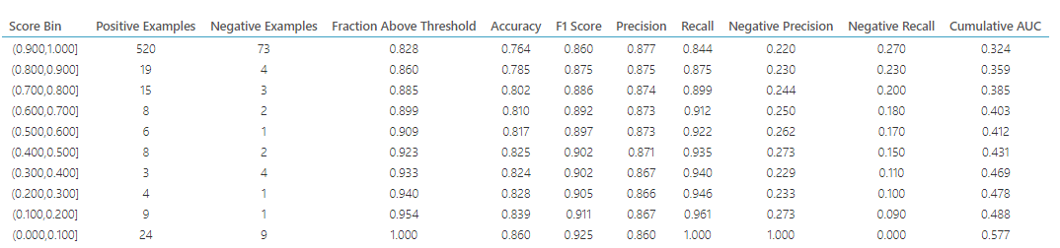
Boosted Decision Forest Tree
Evaluation Metrics
Features used:
Date, Business ID, Review ID, User ID, Funny, Cool, Useful
Label used:
Star
Notes:
T

Slide 25
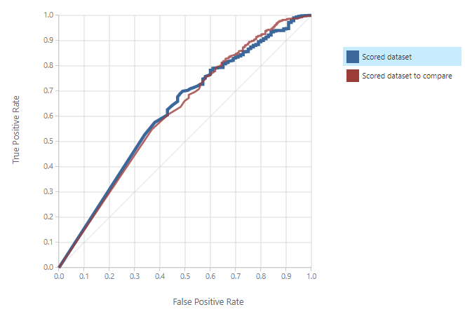
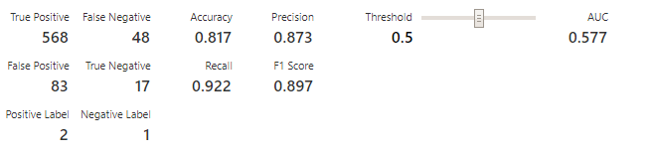
Boosted Decision Forest Tree
Evaluation Metrics
Notes:
T

Slide 26
Comparison
 | Decision Forest Regression | Boosted Decision Tree Regression
AUC | .666 | .577
Recall | 1 | .922
Precision | .860 | .873
Accuracy | .860 | .817
F1 Score | .925 | .897
Notes:
R

Slide 27

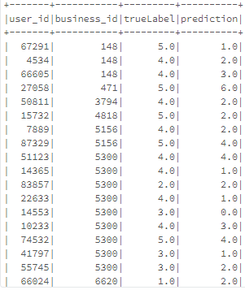
ALS Collaborative Filtering
als = ALS(userCol="user_id", itemCol="business_id", ratingCol="label")
Time Taken: 21 minutes
RMSE = 2.163207289256816
TrainValidationSplit used to build a generalized model
A recommendation model using alternating least square algorithm(ALS)
Notes:
U

Slide 28
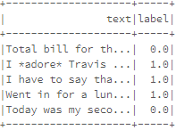
Logistic Regression
Text Analysis
Analyzing text from “text” column to
predict the sentiment
stars > 2 means positive rating(1) else
negative Rating(0)
70:30 Split Train/Test
Tokenizer splits the text column into individual words
StopWordsRemover removes common words
HashingTF generates numeric vectors from the text values
Logistic Regression algorithm used to train model
Notes:
S

Slide 29
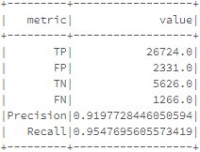
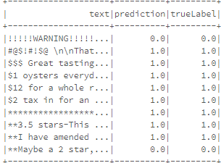
Logistic Regression
Text Analysis
Time Taken = 4 minutes
AUC = 0.8972816931809046
Notes:
S

Slide 30
Challenges Faced
Dataset lacked features related to the users and businesses
The text reviews had a lot of grammar mistakes, spelling mistakes and unnecessary characters
User ID, business ID and review ID all had alphanumeric values

Slide 31
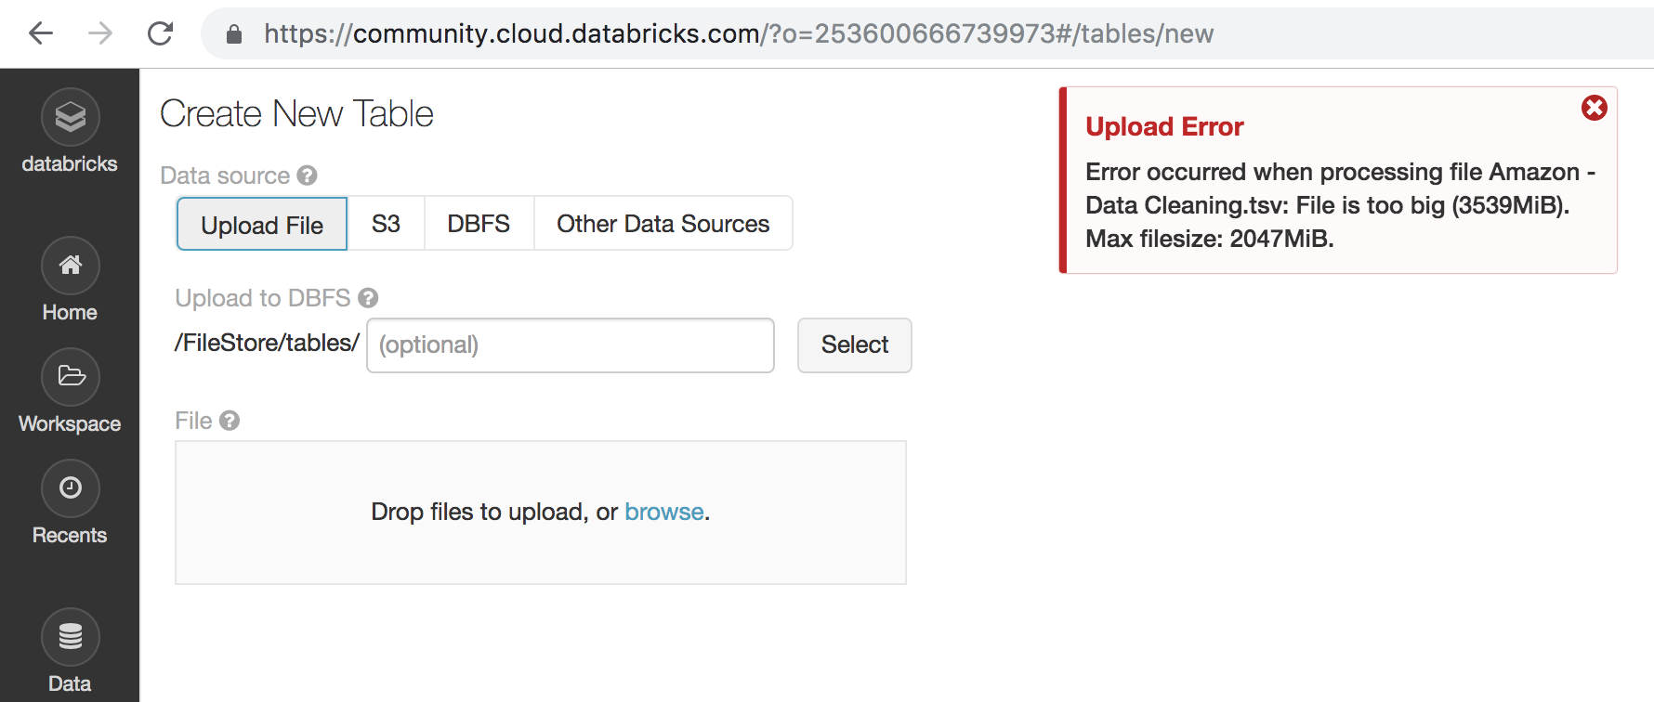

Errors Encountered
Files need to be less than 2GB to successfully upload

Slide 32
Summary of Algorithms
Azure ML | AUR | Time Taken
Decision Forest Regression | .666 | 2 Minutes
Boosted Decision Tree Regression | .577 | 4 Minutes
Spark ML | RMSE | Time Taken
Collaborative Filtering | 2.16 | 25 Minutes
Spark ML | AUR | Time Taken
Text Analytics with Logistic Regression | .897 | 4 Minutes

Slide 33
Conclusion
Recommendation model is implemented to predict the rating prediction based on historic user data
The Decision Forest was better than the Boosted Decision Tree
Help users have a good understanding of the businesses they want to patronize

Slide 34
Github Link
https://github.com/users/Uokafor3/projects/1

Slide 35
References
Apache Spark. (n.d.). Extracting, transforming and selecting features. Retrieved from Apache Spark: https://spark.apache.org/docs/latest/ml-features.html
Ghosh, S. (2018, March 21). Basic data preparation in Pyspark--Capping, Normalizing and Scaling. Retrieved from Medium: https://medium.com/@connectwithghosh/basic-data-preparation-in-pyspark-capping-normalizing-and-scaling-252ee7acba7d

Slide 36
References
Li, S. (2018, May 6). Machine Learning with PySpark and MLlib--Solving a Binary Classification Problem. Retrieved from Towards data science: https://towardsdatascience.com/machine-learning-with-pyspark-and-mllib-solving-a-binary-classification-problem-96396065d2aa

Slide 37
ANY QUESTIONS???

